Slide 1
Biometric Security
CYB 305

Slide 2
What are Biometrics?
The term "biometrics" is derived from the Greek words bio (life) and metric (to measure).
For our use, biometrics refers to technologies for measuring and analyzing a person's physiological or behavioral characteristics.
These characteristics are unique to individuals hence can be used to verify or identify a person.

Slide 3
Current Problems
Based on Passwords, or ID/Swipe cards
Can be Lost.
Can be forgotten.
Worse! Can be stolen and used by a thief/intruder to access your data, bank accounts, car etc….

Slide 4
Current Problems
With increasing use of IT technology and need to protect data, we have multiple accounts/passwords.
We can only remember so many passwords, so we end up using things we know to create them (birthdays, wife/girlfriends name, dog, cat…)
Its is easy to crack passwords, because most of our passwords are weak!
If we create strong passwords (that should be meaningless to us) we will forget them! And there is no way to remember multiple such passwords

Slide 5
Some Examples of Different Biometrics
Face
Fingerprint
Voice
Palm print
Hand Geometry
Iris
Retina Scan
Voice
DNA
Signatures
Gait
Keystroke

Slide 6
Applications + Terminology
Identification:
Match a person’s biometrics against a database to figure out his identity by finding the closest match.
Commonly referred to as 1:N matching
‘Criminal Watch-list’ application scenarios

Slide 7
Applications + Terminology
Verification:
The person claims to be ‘John’, system must match and compare his/hers biometrics with John’s stored Biometrics.
If they match, then user is ‘verified’ or authenticated that he is indeed ‘John’
Access control application scenarios.
Typically referred as 1:1 matching.

Slide 8
Fingerprint Matching
Minutiae based fingerprint Matching
This is one of the most commonly used algorithms for extracting features that characterizes a fingerprint.
The different Minutiae feature locations and types can identify different individuals.
These are what are stored in the Biometric template.
Image & Signal processing used to process fingerprint images

Slide 9
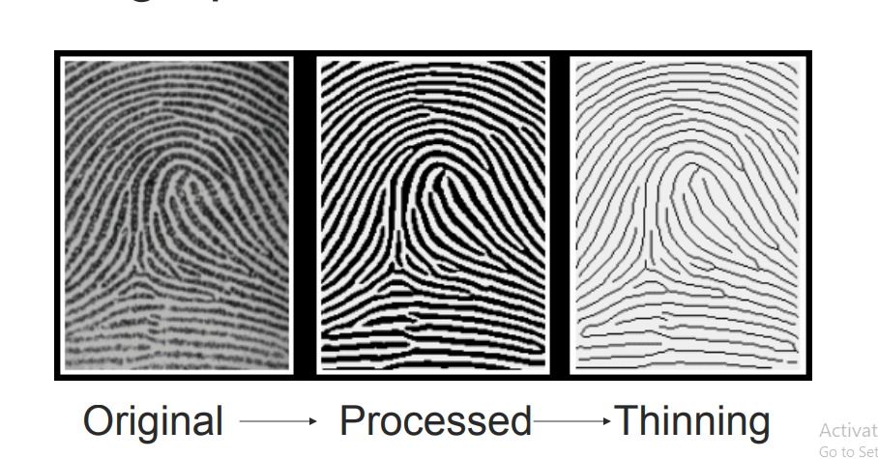
Fingerprint Minutiae Extraction

Slide 10
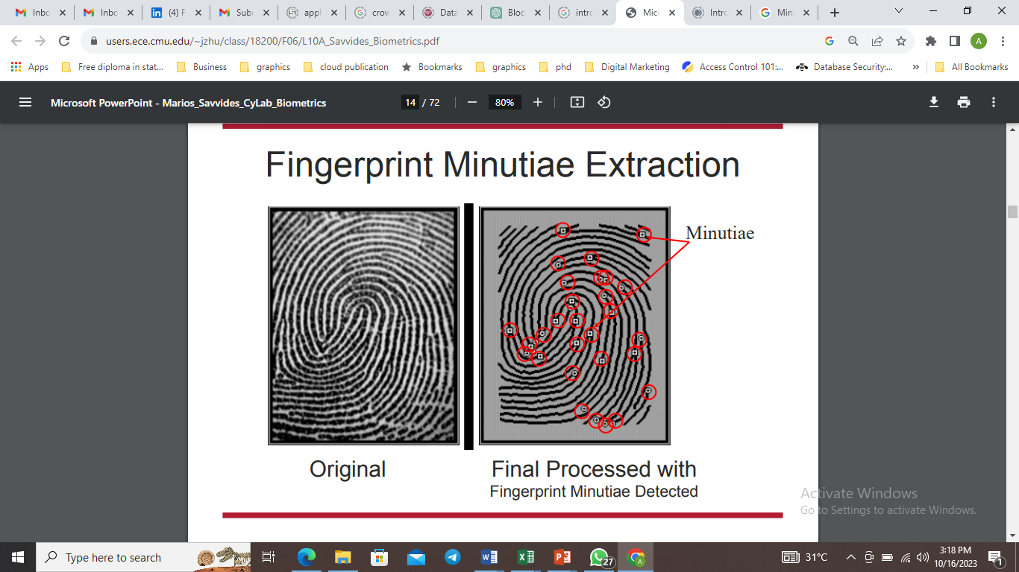
Fingerprint Minutiae Extraction

Slide 11
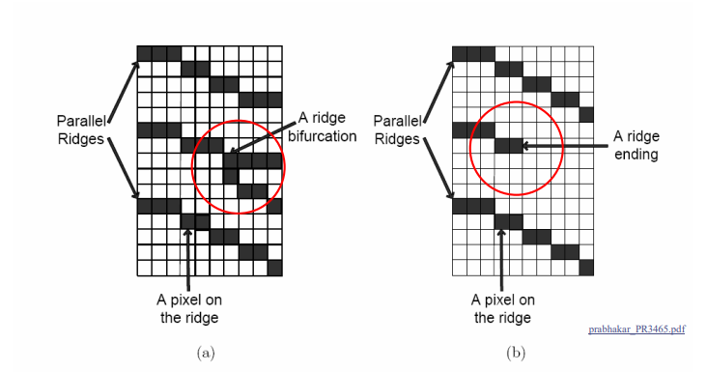
Some example Minutiae types

Slide 12
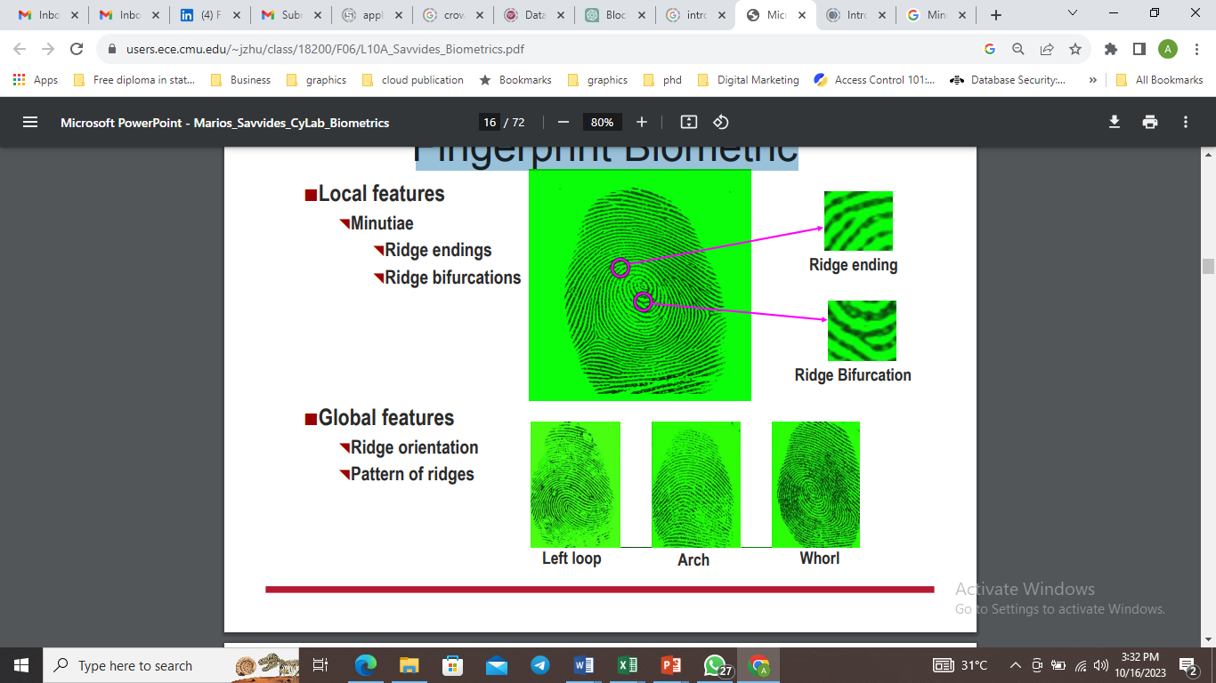
Fingerprint Biometric

Slide 13
Fingerprint Compression
Why do we need compression? We have gigabytes of storage right?
FBI has been collecting fingerprint cards since 1924! Their collection has grown to over 200 million cards occupying an acre of filing cabinets in the J. Edgar Hoover building back in Washington!
This includes some 29 million records they examine each time they're asked to `round up the usual suspects’!
Need over 2,000 Terrabytes of storage..and this number is growing! 30,000-50,000 new cards per day!

Slide 14
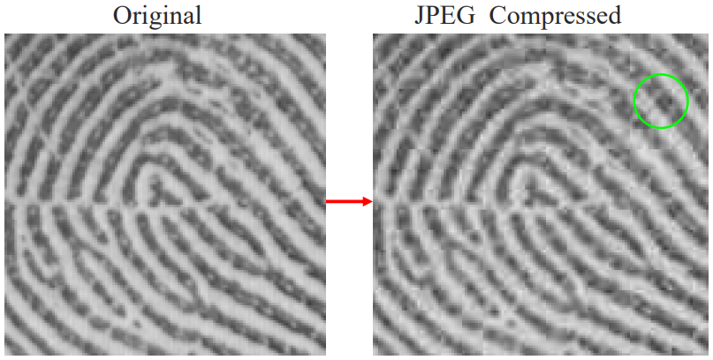
Types of Compression
JPEG compression has too many ‘blocky’ artifacts (it uses an 8x8/16x16 transform coder)

Slide 15
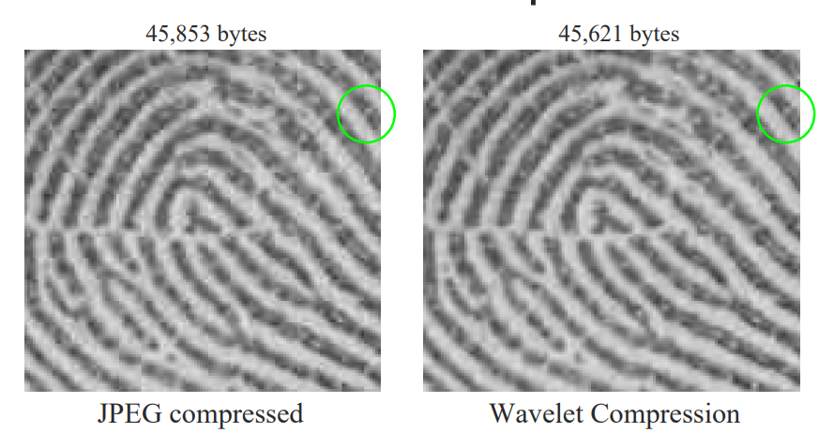
Wavelet Compression
Wavelet Compression uses less compression artifacts!

Slide 16
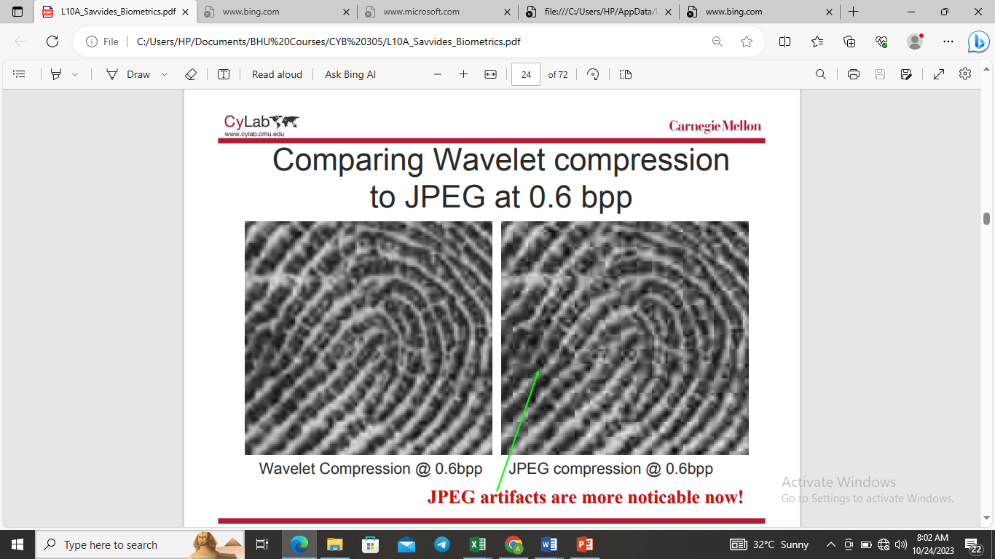
Comparisons

Slide 17
Liveliness Tests
• Possible solutions being explored:
– Measure temperature
– Measure current flow (inject a small voltage across the fingerprint)
– Use IR Led sensors to look for blood veins

Slide 18
Fingerprint Sensors
Different Fingerprint Sensors
• Optical Sensors
– Optic reflexive
– Optic Transmissive
– Fiber Optic Plate
• Capacitative/semiconductor Sensors
– Static Capacitative I, II
– Dynamic Capacitative
• Ultrasound sensor

Slide 19
Pros / Con
Semiconductor (capacitative) sensors are considered to be Low Cost. (but some are prone to ESD (Eletro-Static Discharge) problems over long term use.
• Optical Sensors are considered to have a high degree of stability and reliability. (No ESD problems), however are larger in size!
• Ultrasound Sensors are very precise and fraud-free but expensive to implement

Slide 20
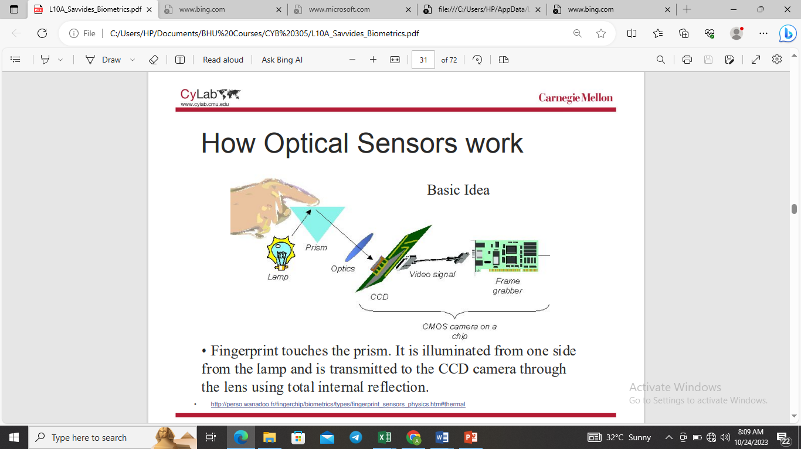
How Optical Sensors Work
• Fingerprint touches the prism. It is illuminated from one side from the lamp and is transmitted to the CCD camera through the lens using total internal reflection

Slide 21
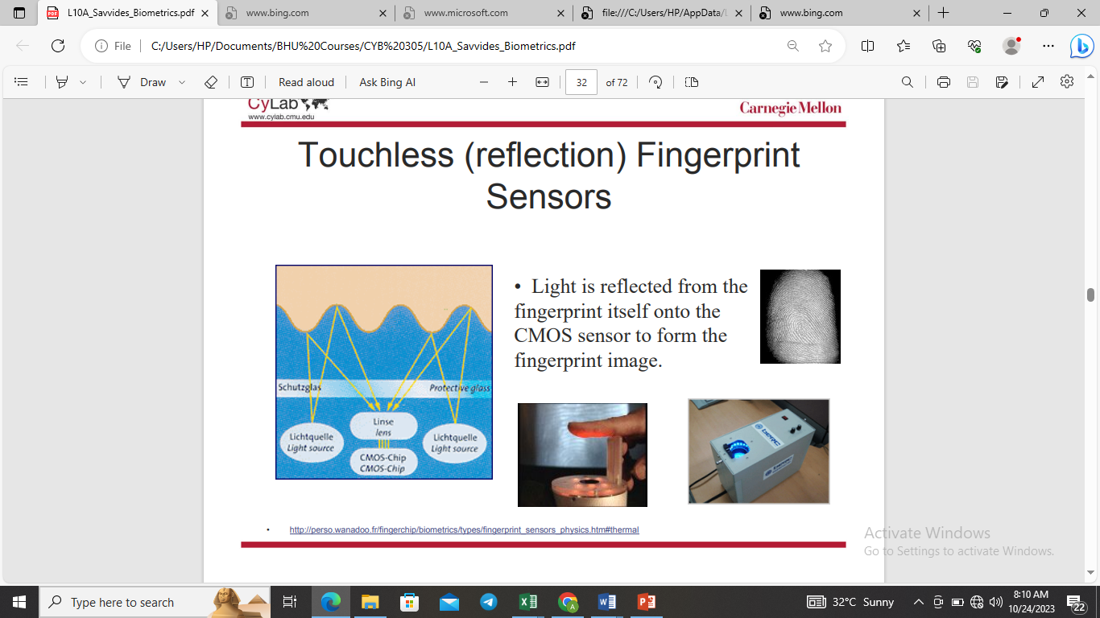
Touchless (refelection) Fingerprint Sensor
Light is reflected from the fingerprint itself onto the CMOS sensor to form the fingerprint image

Slide 22
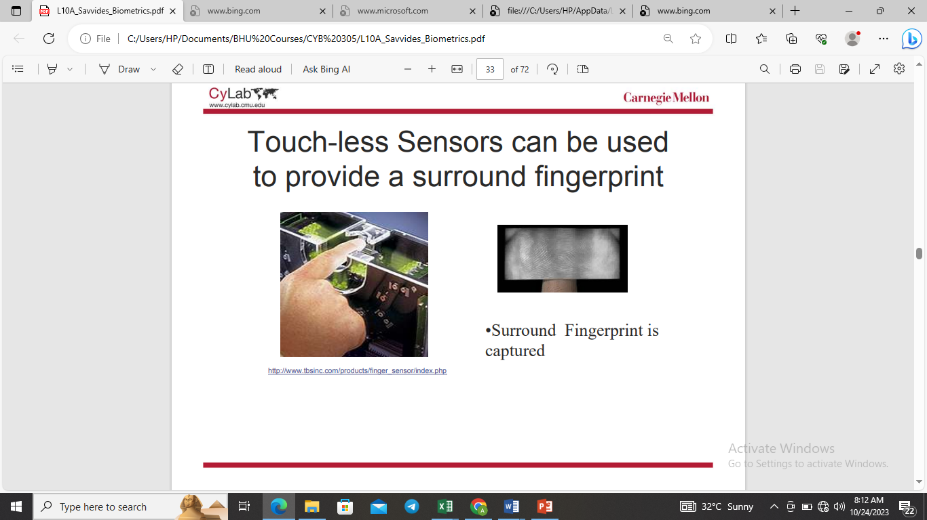
Surround Fingerprint Capture

Slide 23
Capacitative Sensors
These sensors measure the capacitance between the skin and the sensor to acquire fingerprints.
Ridge and valleys of a fingerprint have different capacitance which provide a signature to output a fingerprint image.
These sensors are typically very cheap but are prone to damage by electro-static discharge (ESD)

Slide 24
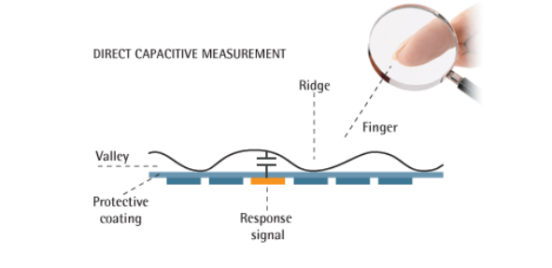
Capacitative Sensors

